Slide 1
Computational thinking and programming -1

Slide 2
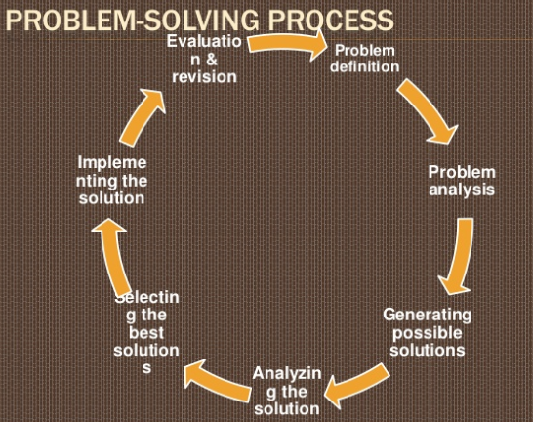

Slide 3
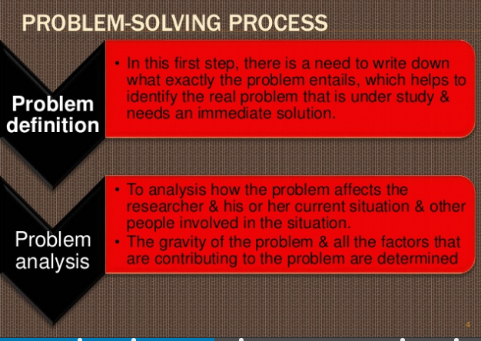

Slide 4
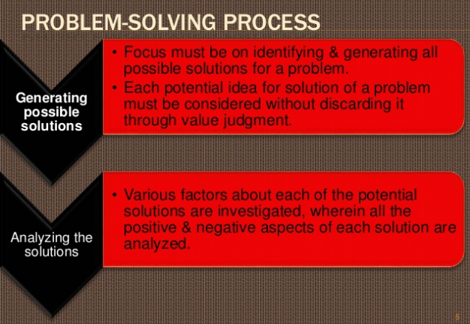

Slide 5


Slide 6
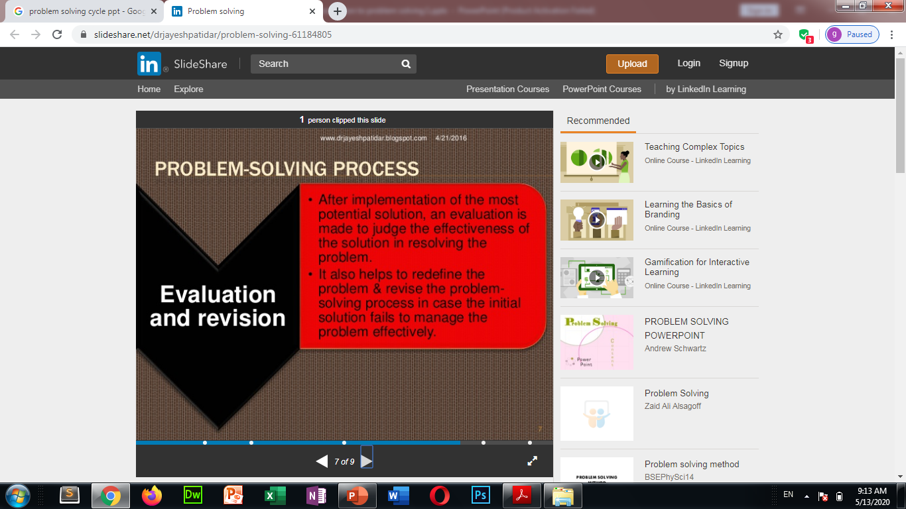

Slide 7
ALGORITHM
In computer science, is a finite sequence of well-defined, computer-implementable instructions, typically to solve a class of problems or to perform a computation. Algorithms are always unambiguous and are used as specifications for performing calculations, data processing, automated reasoning, and other tasks.
As an effective method, an algorithm can be expressed within a finite amount of space and time,and in a well-defined formal language for calculating a function. Starting from an initial state and initial input , the instructions describe a computation that, when executed, proceeds through a finite number of well-defined successive states, eventually producing "output" and terminating at a final ending state.

Slide 8
DESIGNING ALGORITHMS
Algorithm design refers to a method for problem-solving and engineering algorithms. The design of algorithms is part of many solution theories of operation research, such as dynamic programming. Techniques for designing and implementing algorithm designs are also called algorithm design patterns.

Slide 9
Typical steps in the development of algorithms:
Problem definition
Development of a model
Specification of the algorithm
Designing an algorithm
Checking the correctness of the algorithm
Analysis of algorithm
Implementation of algorithm
Program testing
Documentation preparation

Slide 10
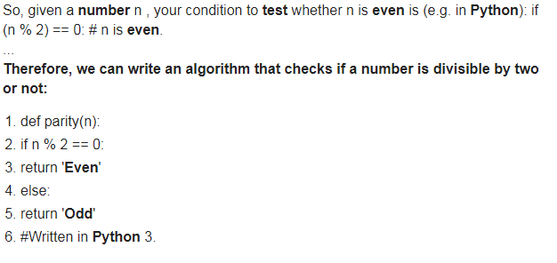
EXAMPLE

Slide 11
EXAMPLE 2
What is the algorithm for finding the greatest of three numbers?
Step 1:Star
Step 2:Read three numbers A,B & C
Step 3:If A>B,then go to step 6
Step 4:If B>C,then print B & go to step 8
Step 5:print C is greatest & go to step 8
Step 6:If A>C,then print A is greatest & go to step 8
Step 7:Print C is greatest
Step 8:end
Sign In
Quora uses cookies to improve your experience. Read more

Slide 12
Flowchart
A flowchart is a type of diagram that represents a workflow or process. A flowchart can also be defined as a diagrammatic representation of an algorithm, a step-by-step approach to solving a task.
The flowchart shows the steps as boxes of various kinds, and their order by connecting the boxes with arrows. This diagrammatic representation illustrates a solution model to a given problem. Flowcharts are used in analyzing, designing, documenting or managing a process or program in various fields.

Slide 13
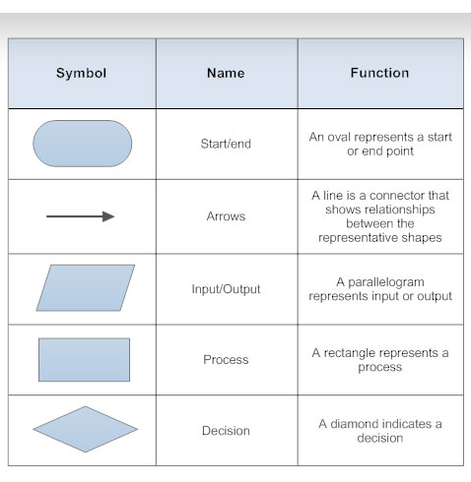
Flowchart symbols

Slide 14
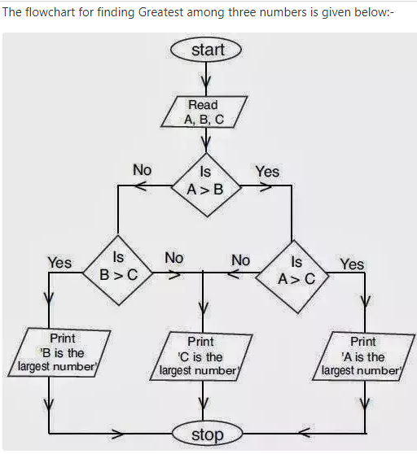

Slide 15
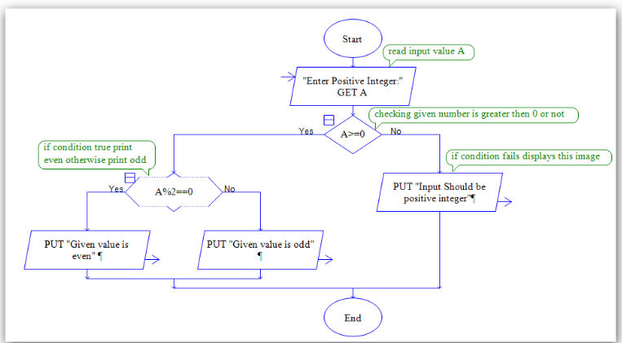
Flowchart to check entered number is even or odd

Slide 16
Pseudocode
In computer science, pseudocode is an informal high-level description of the operating principle of a computer program or other algorithm. It uses the structural conventions of a normal programming language, but is intended for human reading rather than machine reading.
Pseudocode to Check Whether Number is Odd or Even
1st Method: 0. Start 1. Print "Enter Any Number to Check, Even or Odd" 2. Read input of a number 3. If number mod = 0 4. Print "Number is Even" 5. Else 6. Print "Number is Odd" 7. End

Slide 17
Decomposition
Decomposition is the process of breaking down a complex problem or system into smaller, more easily solved parts. These smaller problems are solved one after another until the bigger complex problem is solved.
This stage involves breaking down the problem into smaller components so that they can be tackled easily. The more you can break down a problem, the easier it is to solve.
Some real-life examples of decomposition process are:
F When we give someone directions to our house, we are decomposing the process of getting from one place to another (e.g., city, state, etc.).
F In mathematics, we can decompose a number such as 256.37 as follows: 2*102+5*101+6*100+3*10–1+7*10–2

Slide 18
Python Interactive and script mode
Basic python programming
Python has two basic modes: script and interactive. The normal mode is the mode where the scripted and finished .py files are run in the Python interpreter. Interactive mode is a command line shell which gives immediate feedback for each statement, while running previously fed statements in active memory. As new lines are fed into the interpreter, the fed program is evaluated both in part and in whole.
interactive
>>> 5 5 >>> print(5*7) 35 >>> "hello" * 4 'hellohellohellohello' >>> "hello".__class__ <type 'str'>
Script
if 1:
print("True")
print("Done")

Slide 19
Python data types
Integers
In Python 3, there is effectively no limit to how long an integer value can be. Of course, it is constrained by the amount of memory your system has, as are all things, but beyond that an integer can be as long as you need it to be:
>>>>>>
(123123123123123123123123123123123123123123123123 + 1) 123123123123123123123123123123123123123123123124
Floating-Point Numbers
The float type in Python designates a floating-point number. float values are specified with a decimal point.
>>>>>> 4.2 4.2 >>>
(4.2) <class 'float'>
Strings
Strings are sequences of character data. The string type in Python is called str.
String literals may be delimited using either single or double quotes. All the characters between the opening delimiter and matching closing delimiter are part of the string:
>>>>>>
("I am a string.") I am a string. >>>
("I am a string.") <class 'str'>

Slide 20
Thanks

